Slide 1

CONSUMER PERSONAL LOANS APPROVAL PREDICTION MODEL
Company : SSJ IT Solutions Pvt. Ltd.
Domain : Machine Learning
Name : Jeeva K
Intern ID : ML01006

Slide 2
Prediction of Approval of Consumer Personal Loans Applications using different Machine Learning Algorithms. The Dataset containing 18 different Columns There are,
Loanapp_ID
Sex
Marital_Status
first_name
last_name
email
address
Dependents
Qual_var
SE
App_Income_1
App_Income_2
CPL_Amount
CPL_Term
Credit_His
Prop_Area
INT_ID
Prev_ID
AGT_ID
CPL_Status
So, we have to analyze data and meaningful insights from it

Slide 3
DATA PREPROCESSING TECHNIQUES
Missing values
Data Cleaning
Extract Features
Feature Encoding
Label Encoding
Handle Outliers
Separate Independent and dependent Features then Select
To Find Best Feature

Slide 4
DATA EXPLORATION
Data exploration is a key aspect of data analysis and model building. Without spending significant time on understanding the data and its patterns one cannot expect to build efficient predictive models. Data exploration takes major chunk of time in a data science project comprising of data cleaning and preprocessing

Slide 5
DATA VISUALIZATION
Data visualization is the graphical representation of data in order to explore and visualize data to uncover insights from the start or identify areas or patterns to dig into more.
Using interactive dashboards and point-and-click data exploration, users can better understand the bigger picture and get to insights faster.

Slide 6
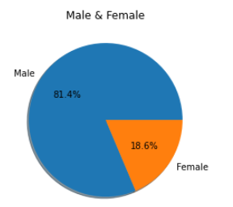
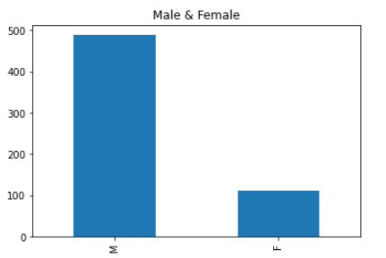
GENDER ANALYSIS

Slide 7
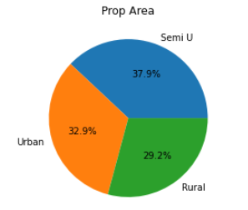
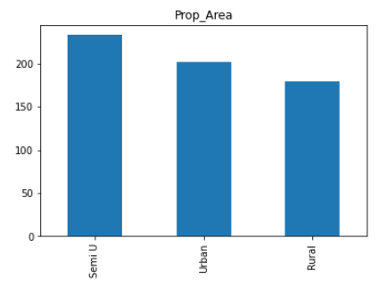
PROP AREA ANALYSIS

Slide 8
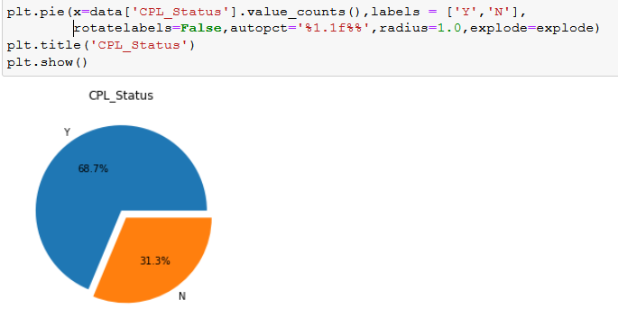
CPL_STATUS ANALYSIS

Slide 9
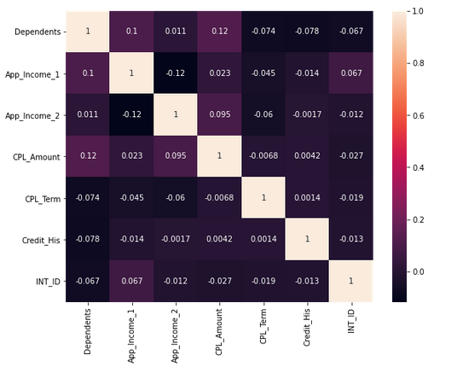
CORRELATION MATRIX

Slide 10
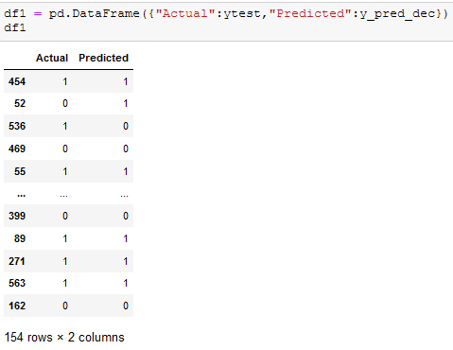
DECISIONTREECLASSIFIER
Decision Tree use to solve different kind of problems like Regression and Classification and It's a Rule based kind of thing. Decision Tree is according to divide into two variables and it's just making decision

Slide 11
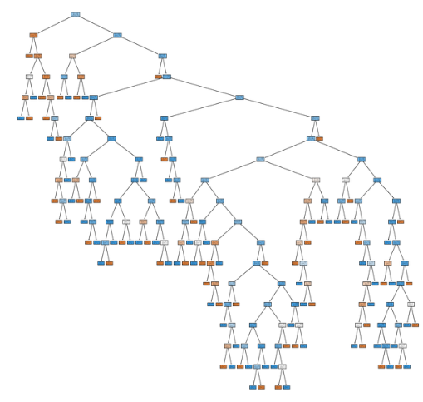
STEP BY STEP PROCESS

Slide 12
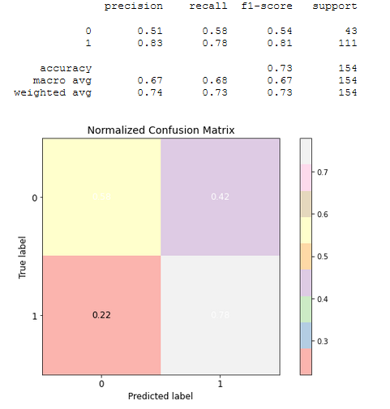

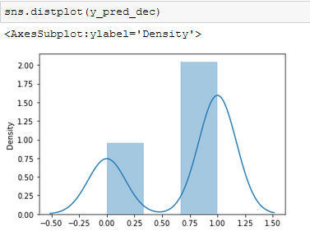
NORMALIZED CONFUSION MATRIX AND ACCURACY

Slide 13
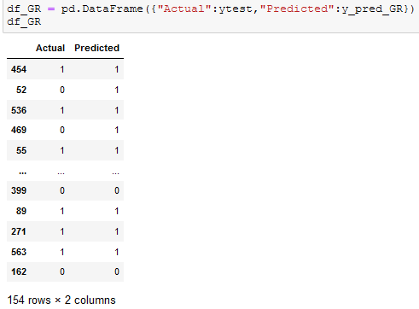
GRADIENT BOOSTING CLASSIFIER
Gradient boosting classifiers are a group of machine learning algorithms that combine many weak learning models together to create a strong predictive model. Decision trees are usually used when doing gradient boosting

Slide 14
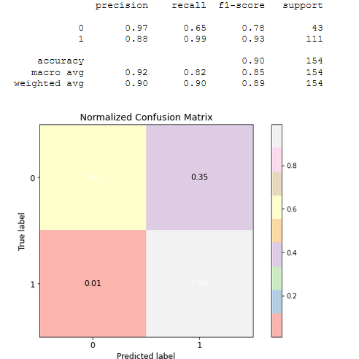

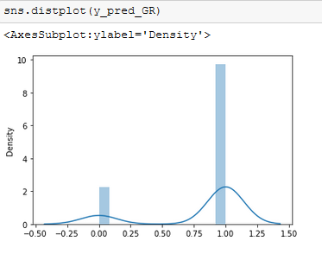
NORMALIZED CONFUSION MATRIX AND ACCURACY

Slide 15
BERNOULLI NAIVE BAYES CLASSIFIER
Bernoulli Naive Bayes is a variant of Naive Bayes. So, let us first talk about Naive Bayes in brief. Naive Bayes is a classification algorithm of Machine Learning based on Bayes theorem which gives the likelihood of occurrence of the event. Naive Bayes classifier is a probabilistic classifier which means that given an input, it predicts the probability of the input being classified for all the classes. It is also called conditional probability.

Slide 16
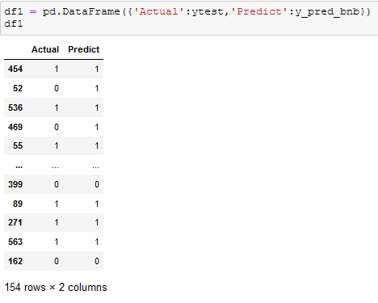
ACTUAL AND PREDICTED DATA

Slide 17
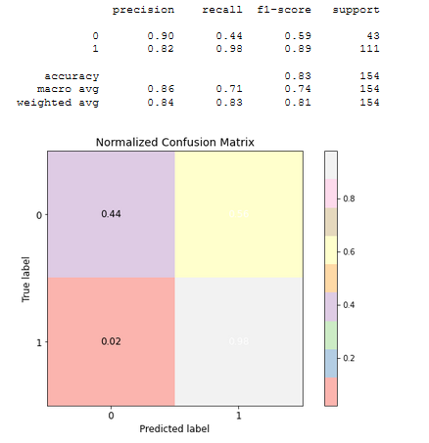

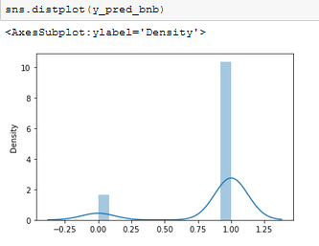
NORMALIZED CONFUSION MATRIX AND ACCURACY

Slide 18
Thank You

